Slide 1
College of Western Idaho SWDV 210 Introduction to Server Side Programming
Week 1 Day 3

Slide 2
SWDV 210 – Day 3 Agenda
Day 3 Topics
Demonstration
Day 3 Lab

Slide 6
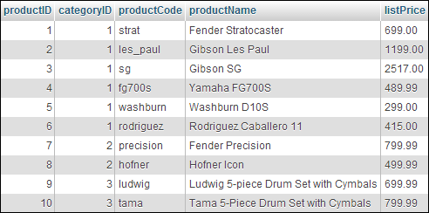
Primary key
Columns
Rows

Slide 8

Primary key
Foreign key

Slide 10
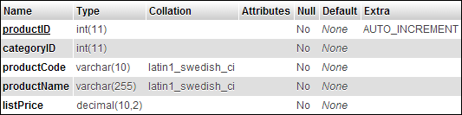

Slide 11
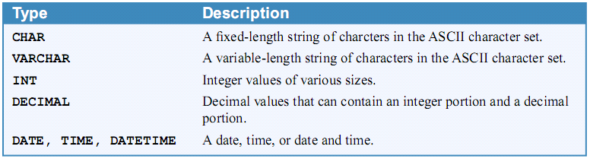

Slide 12

Notes:
In browser:
http://localhost/phpmyadmin | SQL tab
use my_guitar_shop1;
SELECT * FROM products
WHERE categoryID = 2;

Slide 13
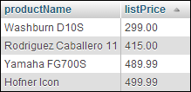
Notes:
use my_guitar_shop1;
SELECT productName, listPrice
FROM products
WHERE listPrice < 500
ORDER BY listPrice ASC

Slide 15

Notes:
use my_guitar_shop1;
SELECT categoryName, productName, listPrice
FROM categories
INNER JOIN products
ON categories.categoryID = products.categoryID
WHERE listPrice > 800
ORDER BY listPrice ASC

Slide 17
Notes:
use my_guitar_shop1;
select count(*) from products;
INSERT INTO products
(categoryID, productCode, productName, listPrice)
VALUES
(1, 'tele', 'Fender Telecaster', 599.00);
select count(*) from products;
use my_guitar_shop1;
select count(*) from orders;
INSERT INTO orders (customerID, orderDate)
VALUES (1, NOW());
select count(*) from orders;

Slide 18
Notes:
use my_guitar_shop1;
Select * from products WHERE productCode = 'ludwig';
UPDATE products
SET productName =
'Ludwig 5-Piece Kit with Zildjian Cymbals'
WHERE productCode = 'ludwig';
Select * from products WHERE productCode = 'ludwig';
use my_guitar_shop1;
Select * from products WHERE categoryID = 1;
UPDATE products
SET listPrice = 299
WHERE categoryID = 1;
Select * from products WHERE categoryID = 1;

Slide 19
Notes:
use my_guitar_shop1;
Select count(*) from products;
DELETE FROM products
WHERE productID = 1;
Select count(*) from products;
use my_guitar_shop1;
Select count(*) from products WHERE listPrice > 200;
DELETE FROM products
WHERE listPrice > 200;
Select count(*) from products WHERE listPrice > 200;

Slide 21
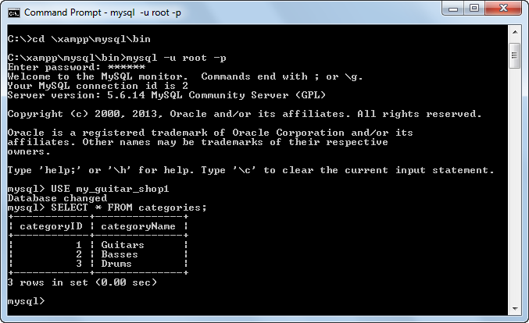
Type this in; do not copy & paste
Notes:
On VM, start xampp control panel | Shell | mysql –uroot –p

Slide 22
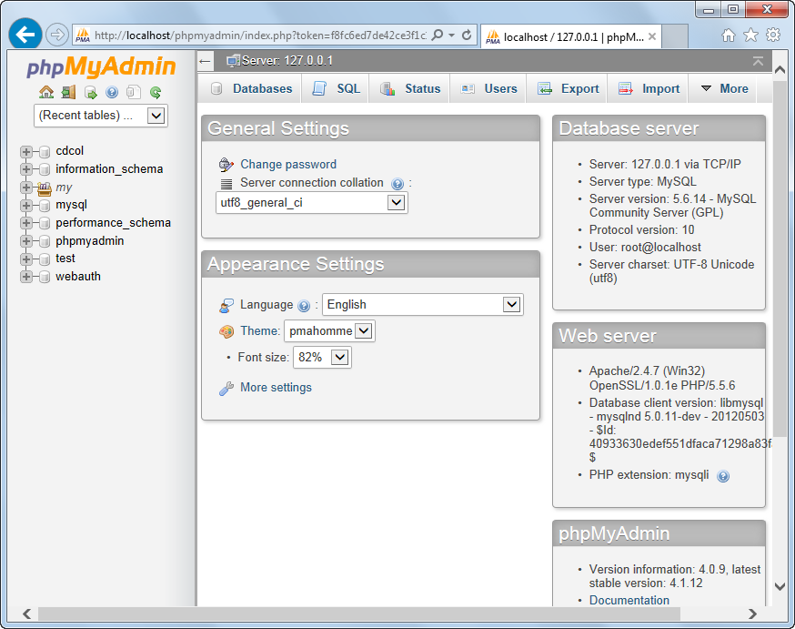
Notes:
http://localhost/phpmyadmin

Slide 23
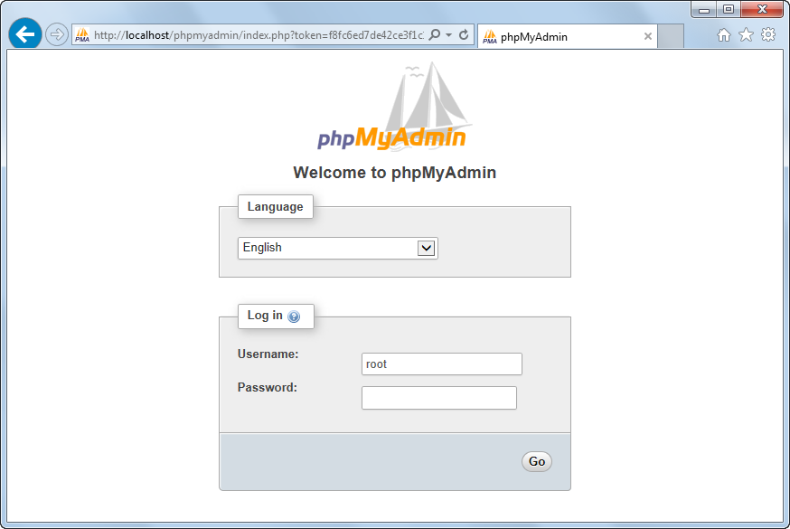
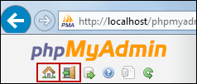

Slide 25
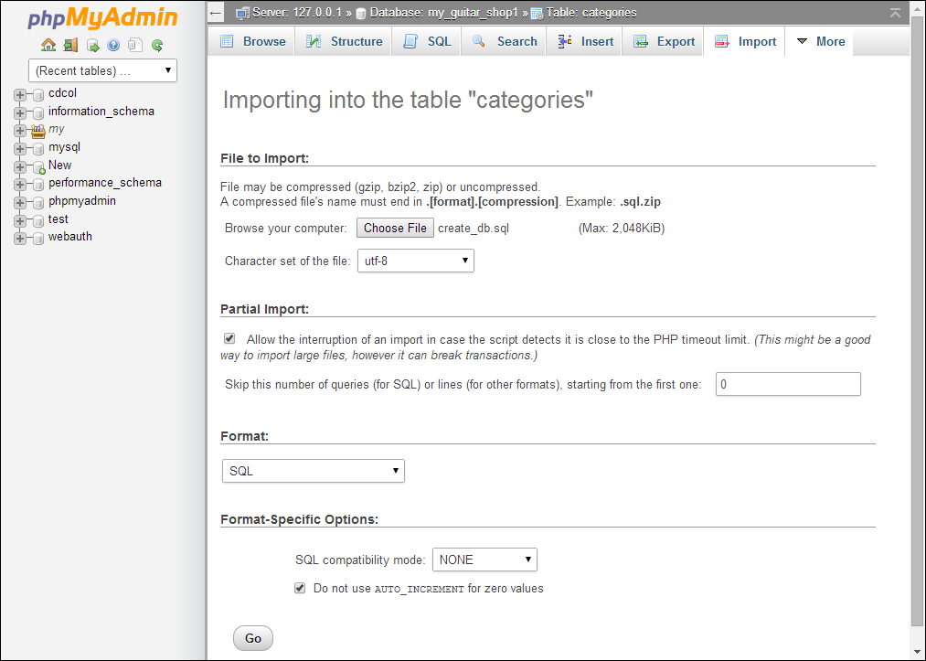

Slide 26
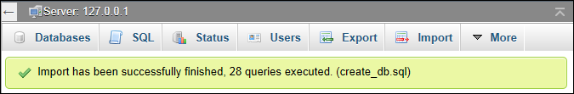

Slide 27
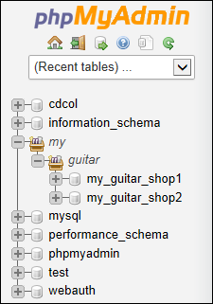
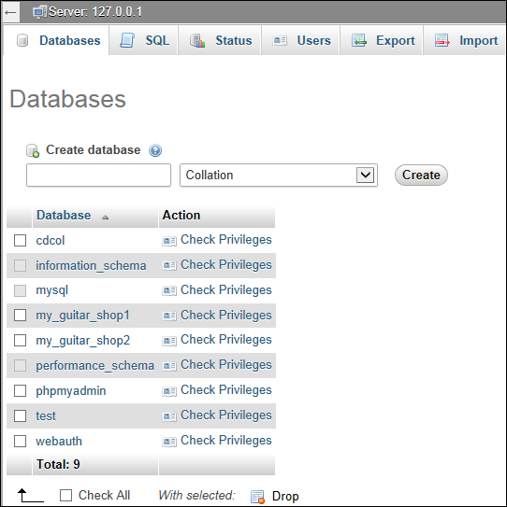

Slide 28
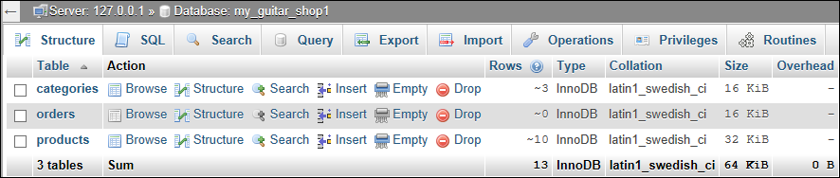

Slide 29
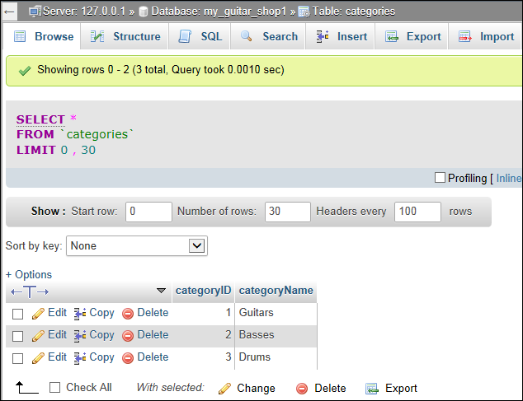

Slide 30
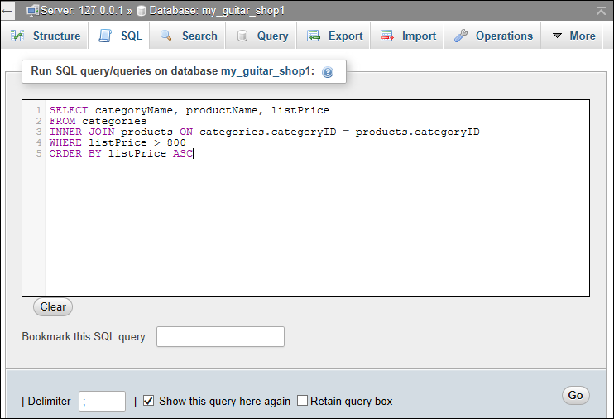

Slide 31
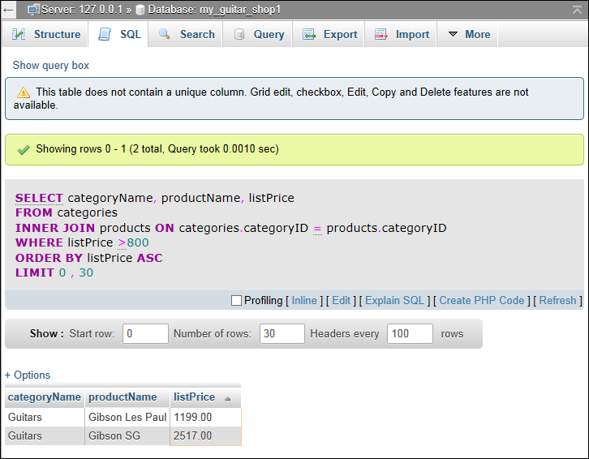

Slide 32
Notes:
Run in phpMyAdmin:
GRANT SELECT
ON my_guitar_shop1.products
TO mgs_tester@localhost
IDENTIFIED BY 'Pa$$w0rd';
GRANT SELECT, INSERT, DELETE, UPDATE
ON my_guitar_shop1.*
TO mgs_user@localhost
IDENTIFIED BY 'Pa$$w0rd';

Slide 34
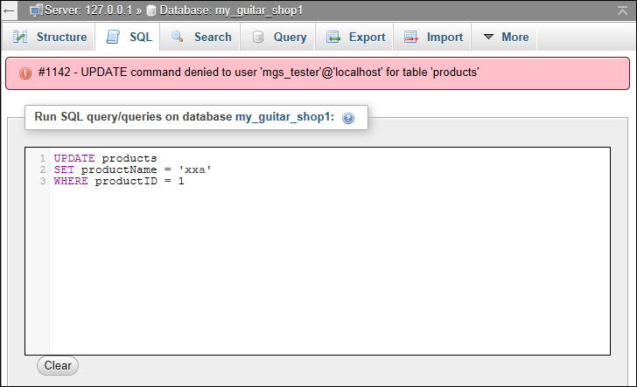

Slide 35
SWDV 210
Questions?

